Slide 1


Extract

Slide 2

OUTLINE
‣
‣
Motivation SQL Basics
‣
‣
Constructing a query Functions
‣
‣
Where should I write SQL queries? Building Connections

Slide 3

“I use databases because its where the
data is.”
rob banks
money
–Willie Sutton

Slide 4
SQL
the structured
language

Slide 5
“SQL is a domain specific language used in programming and … data held in a relational database management system”
–Wikipedia

Slide 6
Structuring a query

Slide 7
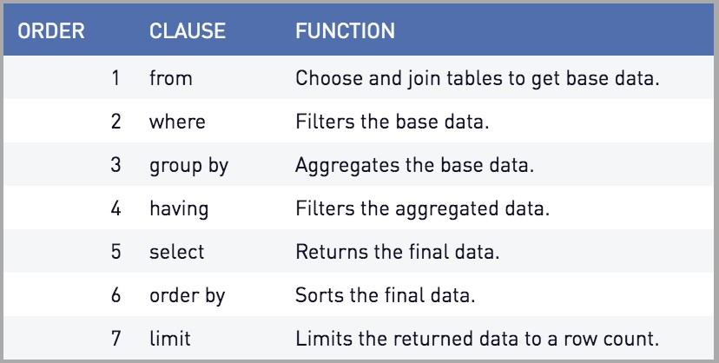

QUERIES
Shiny from
Source: periscope data

Slide 8


EXERCISE
Run apps/wprdc_sql.R
Build a query that selects all of the crimes by neighborhood from the City of Pittsburgh Police Blotter
Hint 1: FROM would be the resource ID (1797ead8-8262-41cc-9099-cbc8a161924b)
Hint 2: The WPRDC uses a Postgresql backend
This means that anything that contains number or capital letters have to be wrapped in quotes

Slide 9

SOLUTION
SELECT * FROM "1797ead8-8262-41cc-9099-cbc8a161924b"

Slide 10
WHERE

Slide 11
BETWEEN … AND
BETWEEN
Grab Values between two other values, like IN but for numeric values
Works like < and >
SELECT column_name(s) FROM table_name
WHERE column_name BETWEEN value1 AND value2;
Shiny from

Slide 12
IN STATEMENTS
Useful for when you have an input that returns multiple
This works the same way %in% does in R
Checks to see if the value in the column matches any of the values in your list
SELECT column_name(s) FROM table_name
WHERE column_name IN (value1, value2, ...)
Shiny from

Slide 13

EXERCISE
Run apps/wprdc_sql.R
This time let’s target 311 requests (resource ID:76fda9d0-69be-4dd5-8108-0de7907fc5a4)
Use the BETWEEN function as a WHERE filter to get 311 requests from from the last week.
Stretch goal: Use the IN Filter to only get requests of the Potholes, Weeds/Debris and Overgrowth call types.

Slide 14
SOLUTION
SELECT * FROM "76fda9d0-69be-4dd5-8108-0de7907fc5a4"
WHERE "CREATED_ON" BETWEEN '2019-09-30' AND '2019-10-06'
SELECT * FROM "76fda9d0-69be-4dd5-8108-0de7907fc5a4"
WHERE "CREATED_ON" BETWEEN '2019-09-30' AND '2019-10-06' AND "REQUEST_TYPE " IN (‘Potholes’, 'Weeds/Debris', 'Overgrowth')

Slide 15
SELECT Functions and GROUP BY

Slide 16
SQL FUNCTIONS
Sometimes you don’t just want the raw data
‣
‣
You want to aggregate the data in SQL before you load it into R
Use another server to do the heavy lifting so you don’t have to!
This is where
‣

Slide 17
DISTINCT
DISTINCT()
Every unique value of a column.
Placing TWO columns inside will return unique instances of both columns:
DISTINCT(“REQUEST_TYPE”, “DEPARTMENT”)

Slide 18
MATH FUNCTIONS
MIN()
Returns minimum value in a column(s)
MAX()
Return max value in a column(s)
COUNT()
Return

Slide 19
COUNT, AVERAGE, SUM
COUNT() - returns the number of rows that your query returns
SELECT COUNT(column_name) FROM table_name
AVG() - returns the average value of a numeric column.
SELECT AVG(column_name) FROM table_name
SUM() - function returns the total sum - numeric columns only
SELECT SUM(column_name) FROM table_name

Slide 20
GROUP BY
This is helpful for when you are doing any of the summary functions mentioned in the previous slides.
(COUNT, SUM, MAX etc)
Any column that isn’t handled with a function should be included in your GROUP BY
SELECT column_name(s), max(column_name) FROM table_name
WHERE condition
GROUP BY column_name(s)

Slide 21
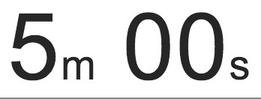
EXERCISE
Run apps/wprdc_sql.R
Build a query that counts the number crimes by neighborhood from the City of Pittsburgh Police Blotter
‣

Slide 22
SOLUTION
SELECT
"INCIDENTNEIGHBORHOOD", COUNT("CCR")
FROM "1797ead8-8262-41cc-9099-cbc8a161924b"
GROUP BY "INCIDENTNEIGHBORHOOD"

Slide 23
Where should I… write my DB queries

Slide 24
SQL IDE’S
There are a bunch of SQL IDE’s each database provider has their own
If you’re in a workplace like mine with no standard then I suggest something like DBeaver because it connects to pretty much everything
If not, then use whatever comes standard with the platform

Slide 25
DB connections in R Not always easy

Slide 26



CONNECTING
‣
Database connectors require that your computer has the necessary software.
This will depend on what database type you are trying to connect to

Slide 27
ALLOWING HANDSHAKES
To setup database connections you will need to install the proper drivers.
The steps for this can be found here: https://db.rstudio.com/best-practices/drivers/
In general setup on Windows is a little bit easier since ODBC Data Source Administrator can be used
‣
‣
Your machine may already have drives installed if you’ve already installed SQL IDE’s such as: pgAdmin, DBeaver, or the MySQL Workbench

Slide 28
Storing credentials

Slide 29
FILE OR ENVIRONMENTAL VARIABLE
You should never “hard code” your credentials into an app.
Instead you should store them as environmental variables, or in a hidden file that you ignore in the
Git Repository
If something requires that you to login, we can assume that not just anybody should be able to access it.
Think of your credentials like your debit card and pin number
Why?
Shiny from

Slide 30
ESTABLISHING CONNECTIONS
Each data base type has a different connection string and list of requirements.
conn <- dbConnect(odbc::odbc(), driver = "FreeTDS", server = "IP_or_HOST_ADDRESS", port = 1433, database = "DBName", uid = un, pwd = pw, TDS_Version = "8.0")
More on connection strings: https://db.rstudio.com/ best-practices/drivers/#connecting-to-a-database-in- r
Shiny from

